Slide 1
Data for Good
Child Poverty Action Lab
Presenters: Vandhana Kalyanaraman & Chung-Min (Jack) Chen

Slide 2
Outline
Methodology
% Accessibility of Jobs with Living Wage
By Transit
30 Mins
60 Mins
By Car
30 Mins
60 Mins
Population
Grocery Stores
Women’s Clinics
Basic Medical Clinics
WIC Centers

Slide 3
Methodology
American Community Survey Data (ACS) => Census Bureau via API (Python)
Data Sources for different Resources => LODES, themap.io, Google Maps
Calculating Travel time => OTP, GTFS
Mapping => QGIS, Tableau
Combining/Aggregating the data => SQL, R, Python

Slide 4
LODES data
CSV data files released at the state level.
3 types: Origin-Destination (OD), Residence Area Characteristic (RAC), Workplace Area Characteristic (WAC) – we use OD.
Each record is available on a Census Block level.
Aggregated to Census Block Group level.
Workplace
Residence
Jobs with different wage range

Slide 5
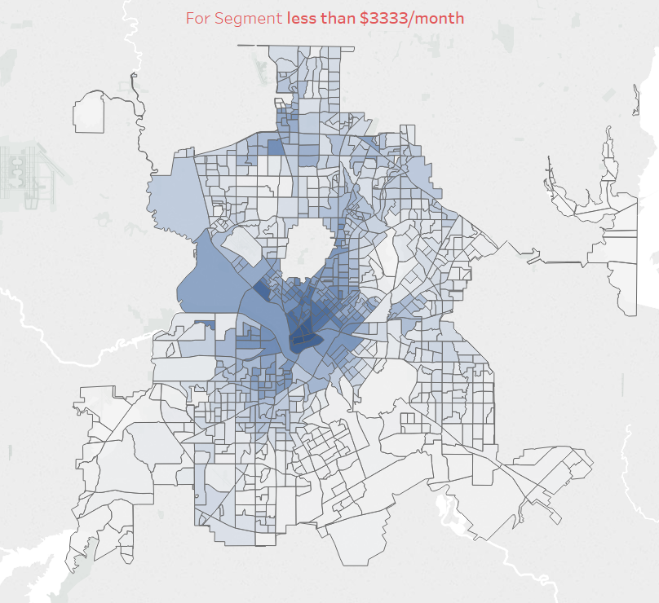
% Accessibility of Jobs within 30 Mins by Transit
Dark Blue
30 – 40 %
Blue
20- 30 %
10 – 20 %
Light Blue
0 – 10 %
White

Slide 6
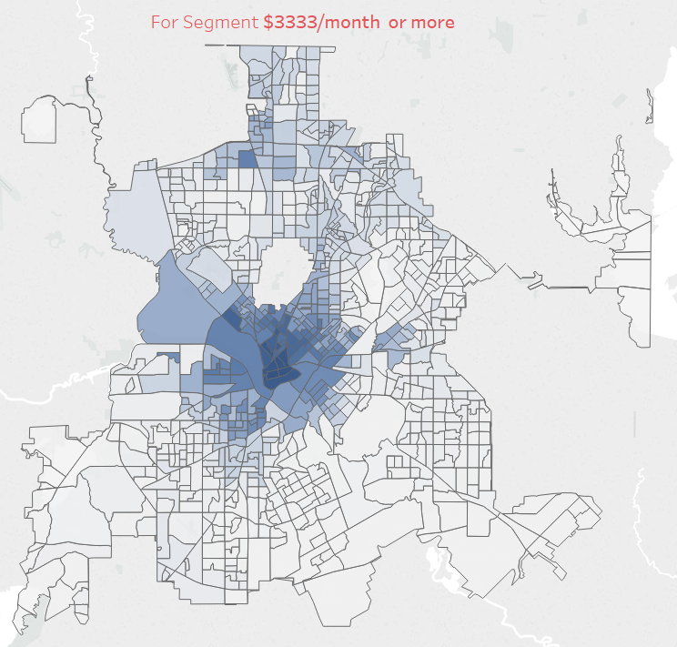
% Accessibility of Jobs within 30 Mins by Transit
Dark Blue
30 – 40 %
Blue
20- 30 %
10 – 20 %
Light Blue
0 – 10 %
White

Slide 7
%Accessibility of Jobs within 30 Mins via Transit
Mode | Within | for < $3333/m | for >$3333/m
Transit | 30 min | max 27% | max 35%
Notes:
10

Slide 8
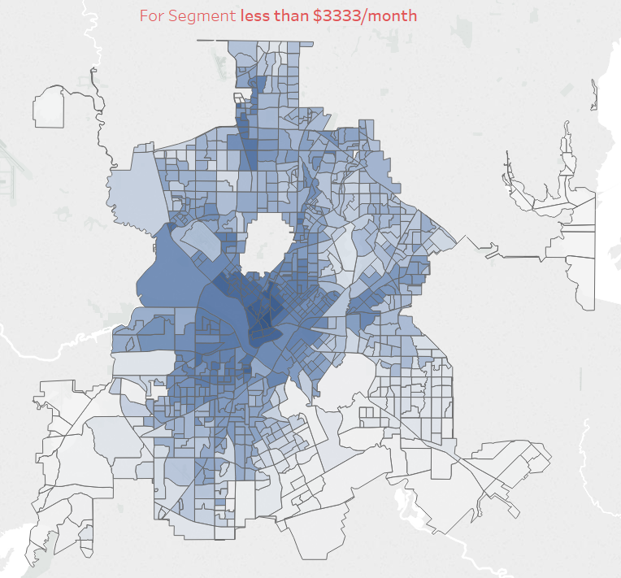
% Accessibility of Jobs within 60 Mins by Transit
Dark Blue
60 – 40 %
Blue
40 - 30 %
30 -10 %
Light Blue
0 – 10%
White

Slide 9
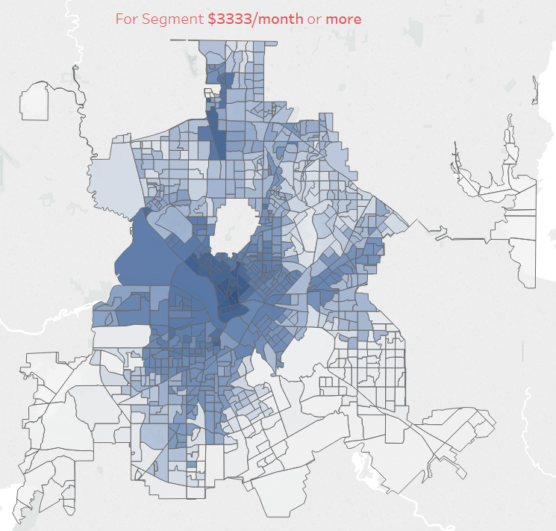
% Accessibility of Jobs within 60 Mins by Transit
Dark Blue
70 – 50 %
Blue
50 - 30 %
30 -10 %
Light Blue
0 – 10%
White

Slide 10
Accessibility of Jobs within 60 Mins via Transit
Mode | Within | for < $3333/m | for >$3333/m
Transit | 30 min | max 27% | max 35%
Transit | 60 min | max 60% | max 69%

Slide 11
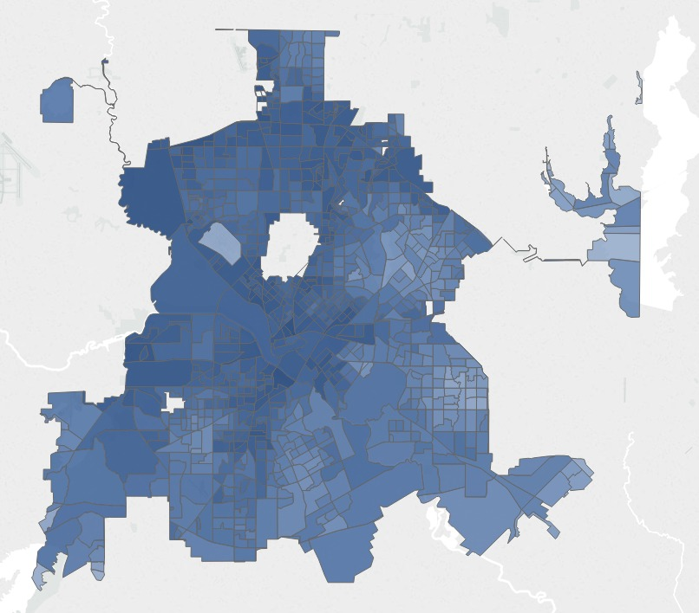
% Accessibility of Jobs within 30 Mins by Car paying < $3333
Dark Blue
75% - 100%
Blue
50% - 75%
25% - 50%
Light Blue
0% – 25%
White

Slide 12
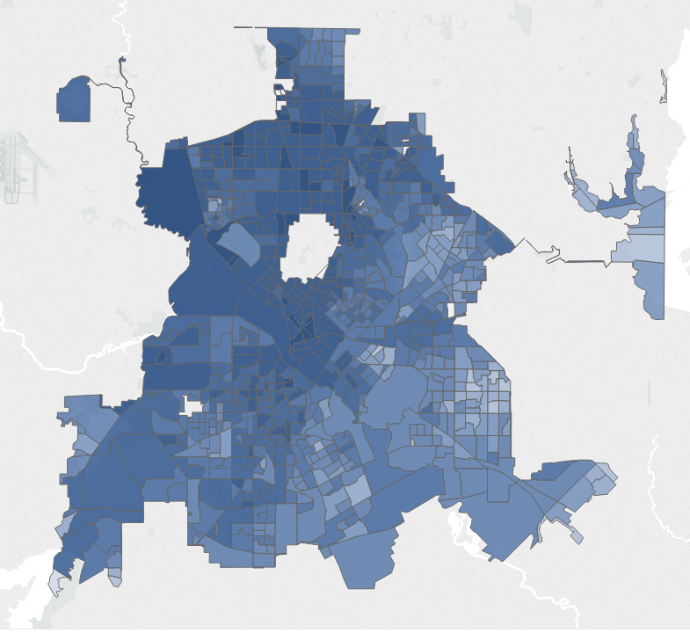
% Accessibility of Jobs within 30 Mins by Car paying > $3333
Dark Blue
75% - 100%
Blue
50% - 75%
25% - 50%
Light Blue
0% – 25%
White

Slide 13
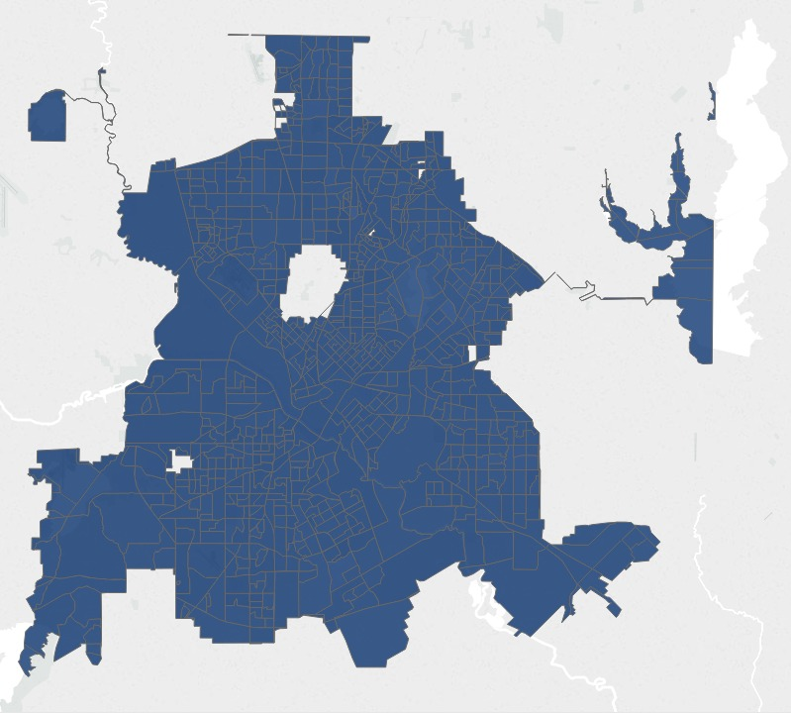
% Accessibility of Jobs within 60 Mins by Car paying < $3333
Dark Blue
75% - 100%
Blue
50% - 75%
25% - 50%
Light Blue
0% – 25%
White

Slide 14
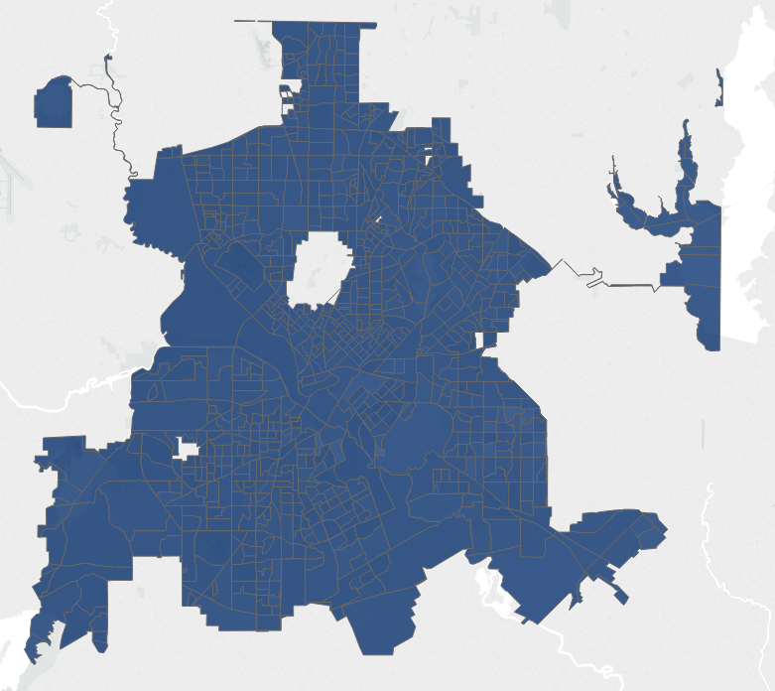
% Accessibility of Jobs within 60 Mins by Car paying > $3333
Dark Blue
75% - 100%
Blue
50% - 75%
25% - 50%
Light Blue
0% – 25%
White

Slide 15
Accessibility to Jobs via Car Insights
Mode | Within | >90% Access to job | >75% Access to job
Car | 30 mins | 3.6% of the CBGs | 43.92% of the CBGs
Car | 60 mins | 99.1% of the CBGS | 99.5% of the CBGs

Slide 16
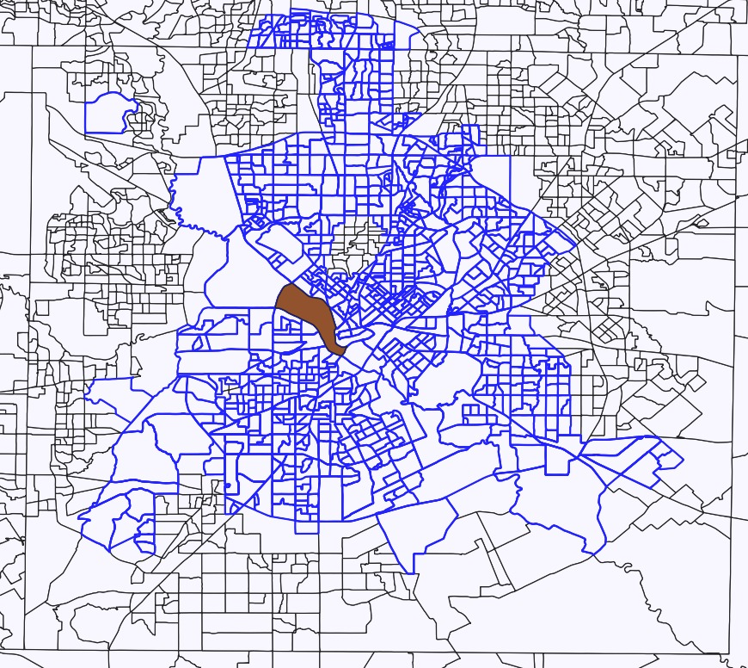
Access to CBG with highest number of jobs
CBG 481130100001 has 11,222 jobs that pays more than living wages
% Access for CBG | Within 30 mins | Within 60 mins
By Car | 90.7% | 99.2%
By Transit | 0.6% | 20%
By Transit within | Avg. waiting time
30 min | 0.025
60 min | 13.12

Slide 17
Recommendations
Subsidized Ride-share solutions
E-Scooters – DART tie up with companies like BIRD, LIME
Increase DART buses frequency, express/shuttle services during peak times to job districts

Slide 18
Methodology
American Community Survey Data (ACS) => Census Bureau via API (Python)
Data Sources for different Resources => LODES, themap.io, Google Maps
Calculating Travel time => OTP, GTFS
Mapping => QGIS, Tableau
Combining/Aggregating the data => SQL, R, Python

Slide 19
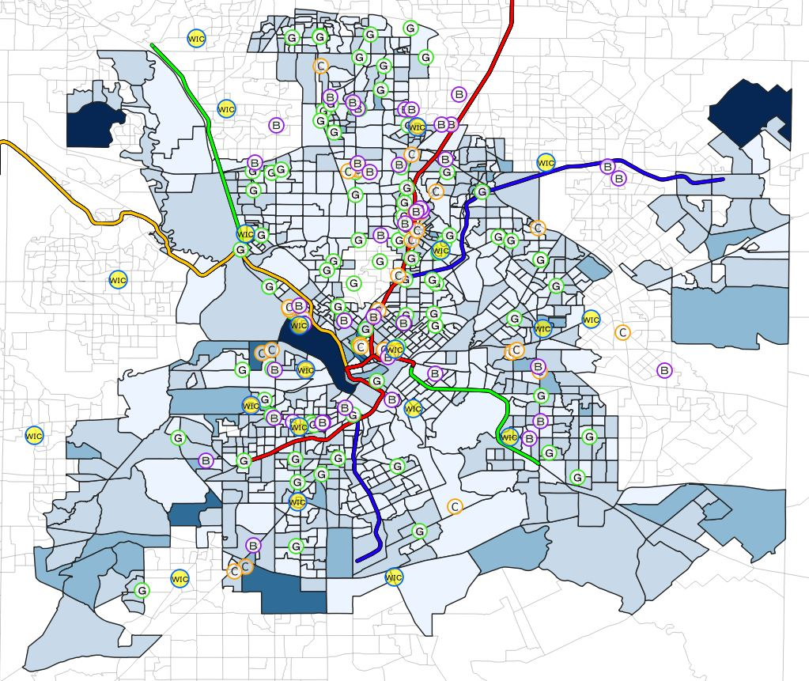
Population
Dark Blue
6000 Above
Blue
4500 – 6000
3000 - 4500
Light Blue
Even Lighter Blue
0 – 1500
White
1500 - 3000

Slide 20
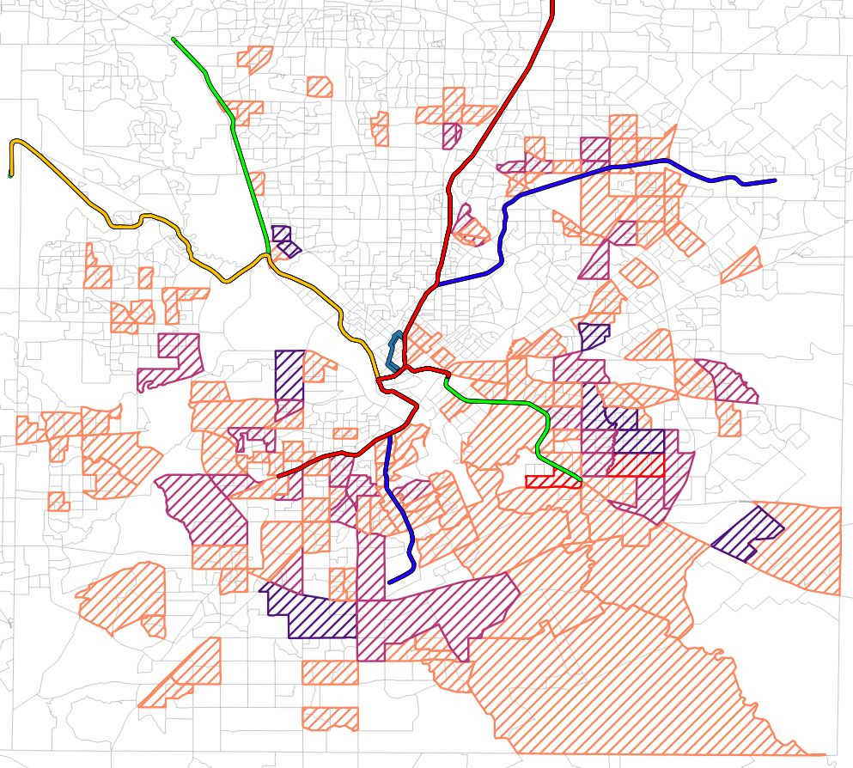
Children in Poverty
Red
80% Above
Dark Purple
60% to 80%
40% to 60%
Light Purple
Orange
Below 20%
Blank
20% to 40%
Percentage of Children in Poverty = Number of Children in Poverty in that CBG / Total Number of Children in Poverty

Slide 21
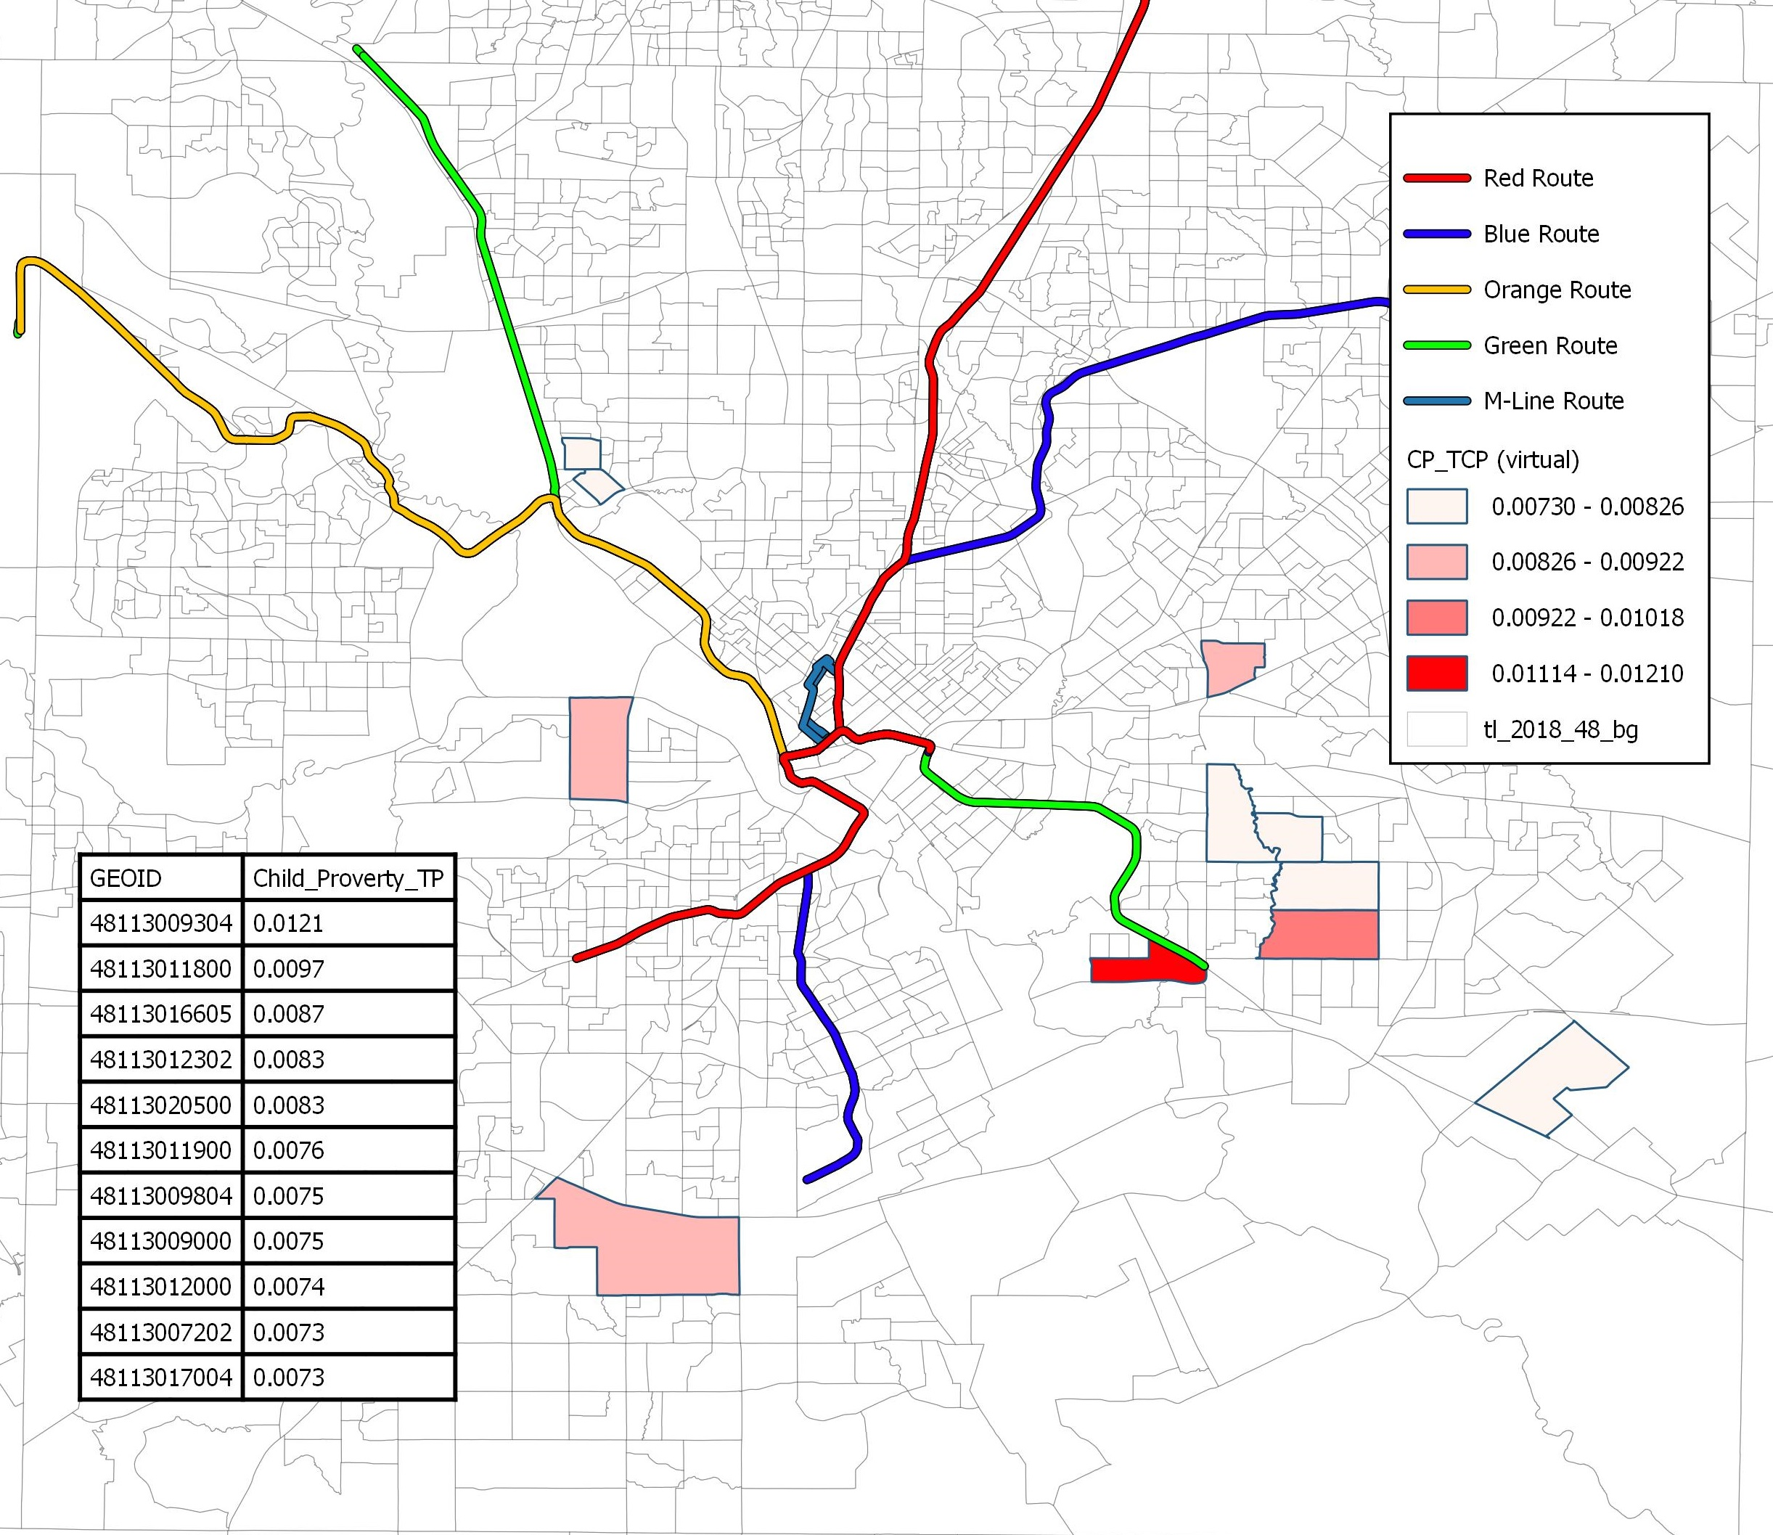
Top 10 Census Tracts with Highest Percentage of Children in Poverty
Percentage of Children in Poverty = Number of Children in Poverty in that CBG / Total Number of Children in Poverty

Slide 22
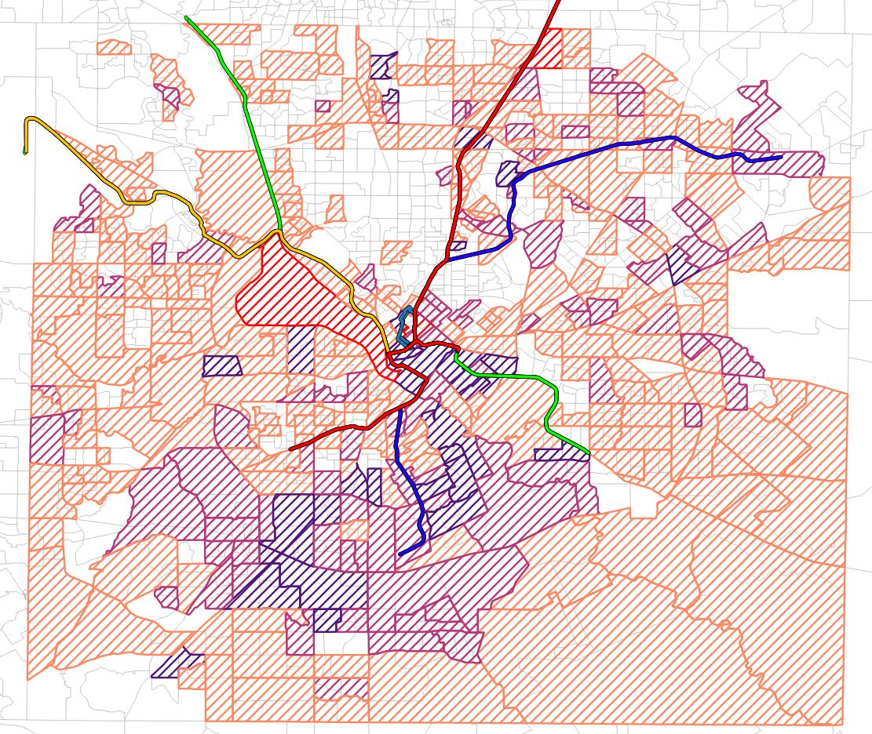
Single Mother Families
Red
80% Above
Dark Purple
60% to 80%
40% to 60%
Light Purple
Orange
Below 20%
Blank
20% to 40%
Percentage of Single Mother Families = Amount of Single Mother Families in that CBG / Total Amount of Single Mother Families
Notes:
Surprisingly the area with the highest percentage of Single Mother Family also is the area with the highest amount of Job with living wage that this CBG can access and it’s also one of the area with highest population within City of Dallas

Slide 23
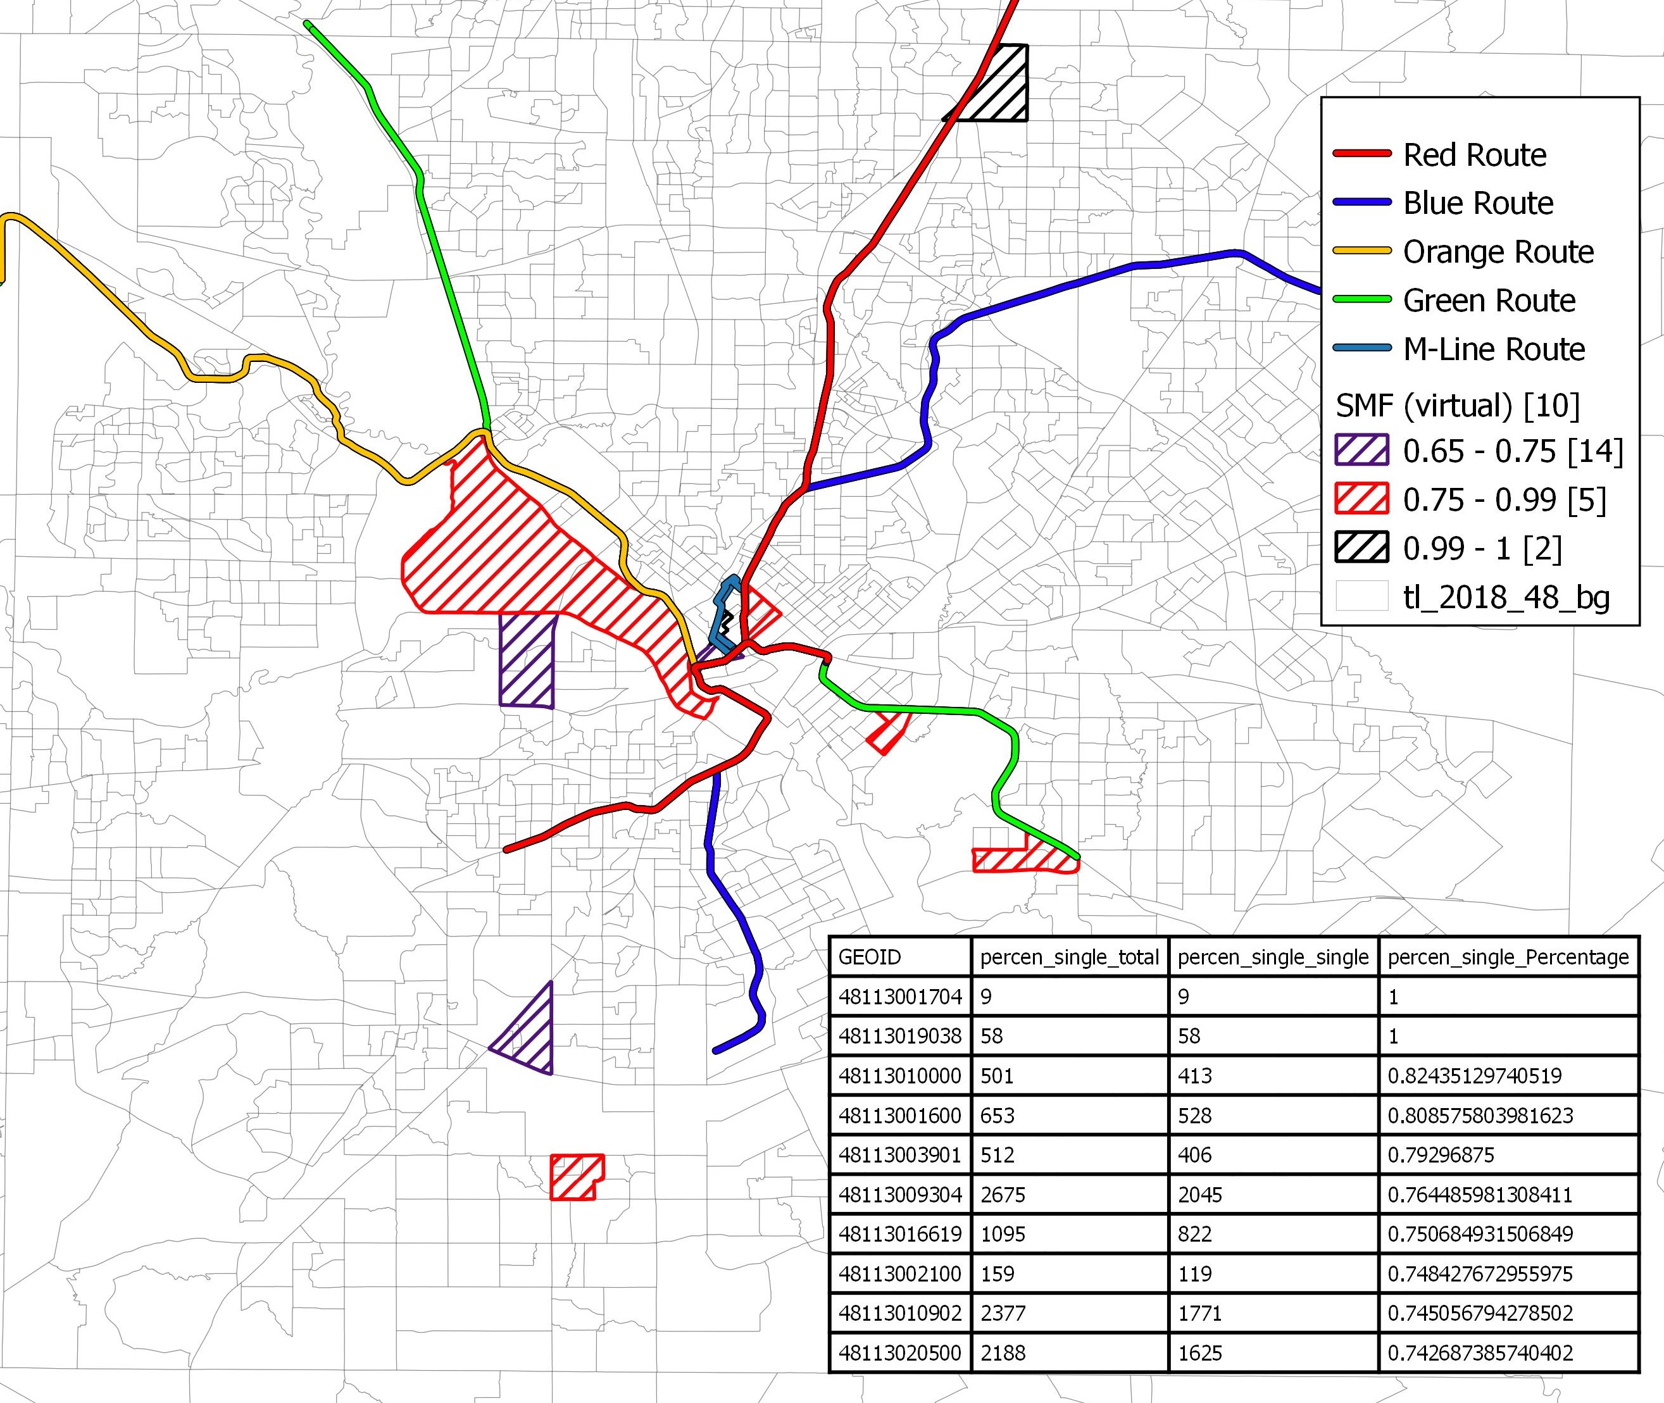
Top 10 Census Tracts with Highest Percentage of Single Mother Families
Percentage of Single Mother Families = Amount of Single Mother Families in that CBG / Total Amount of Families in that CBG (Only Consider families)
Notes:
Sorted by Percentage showing west part of city has higher percentage of single mother family

Slide 24
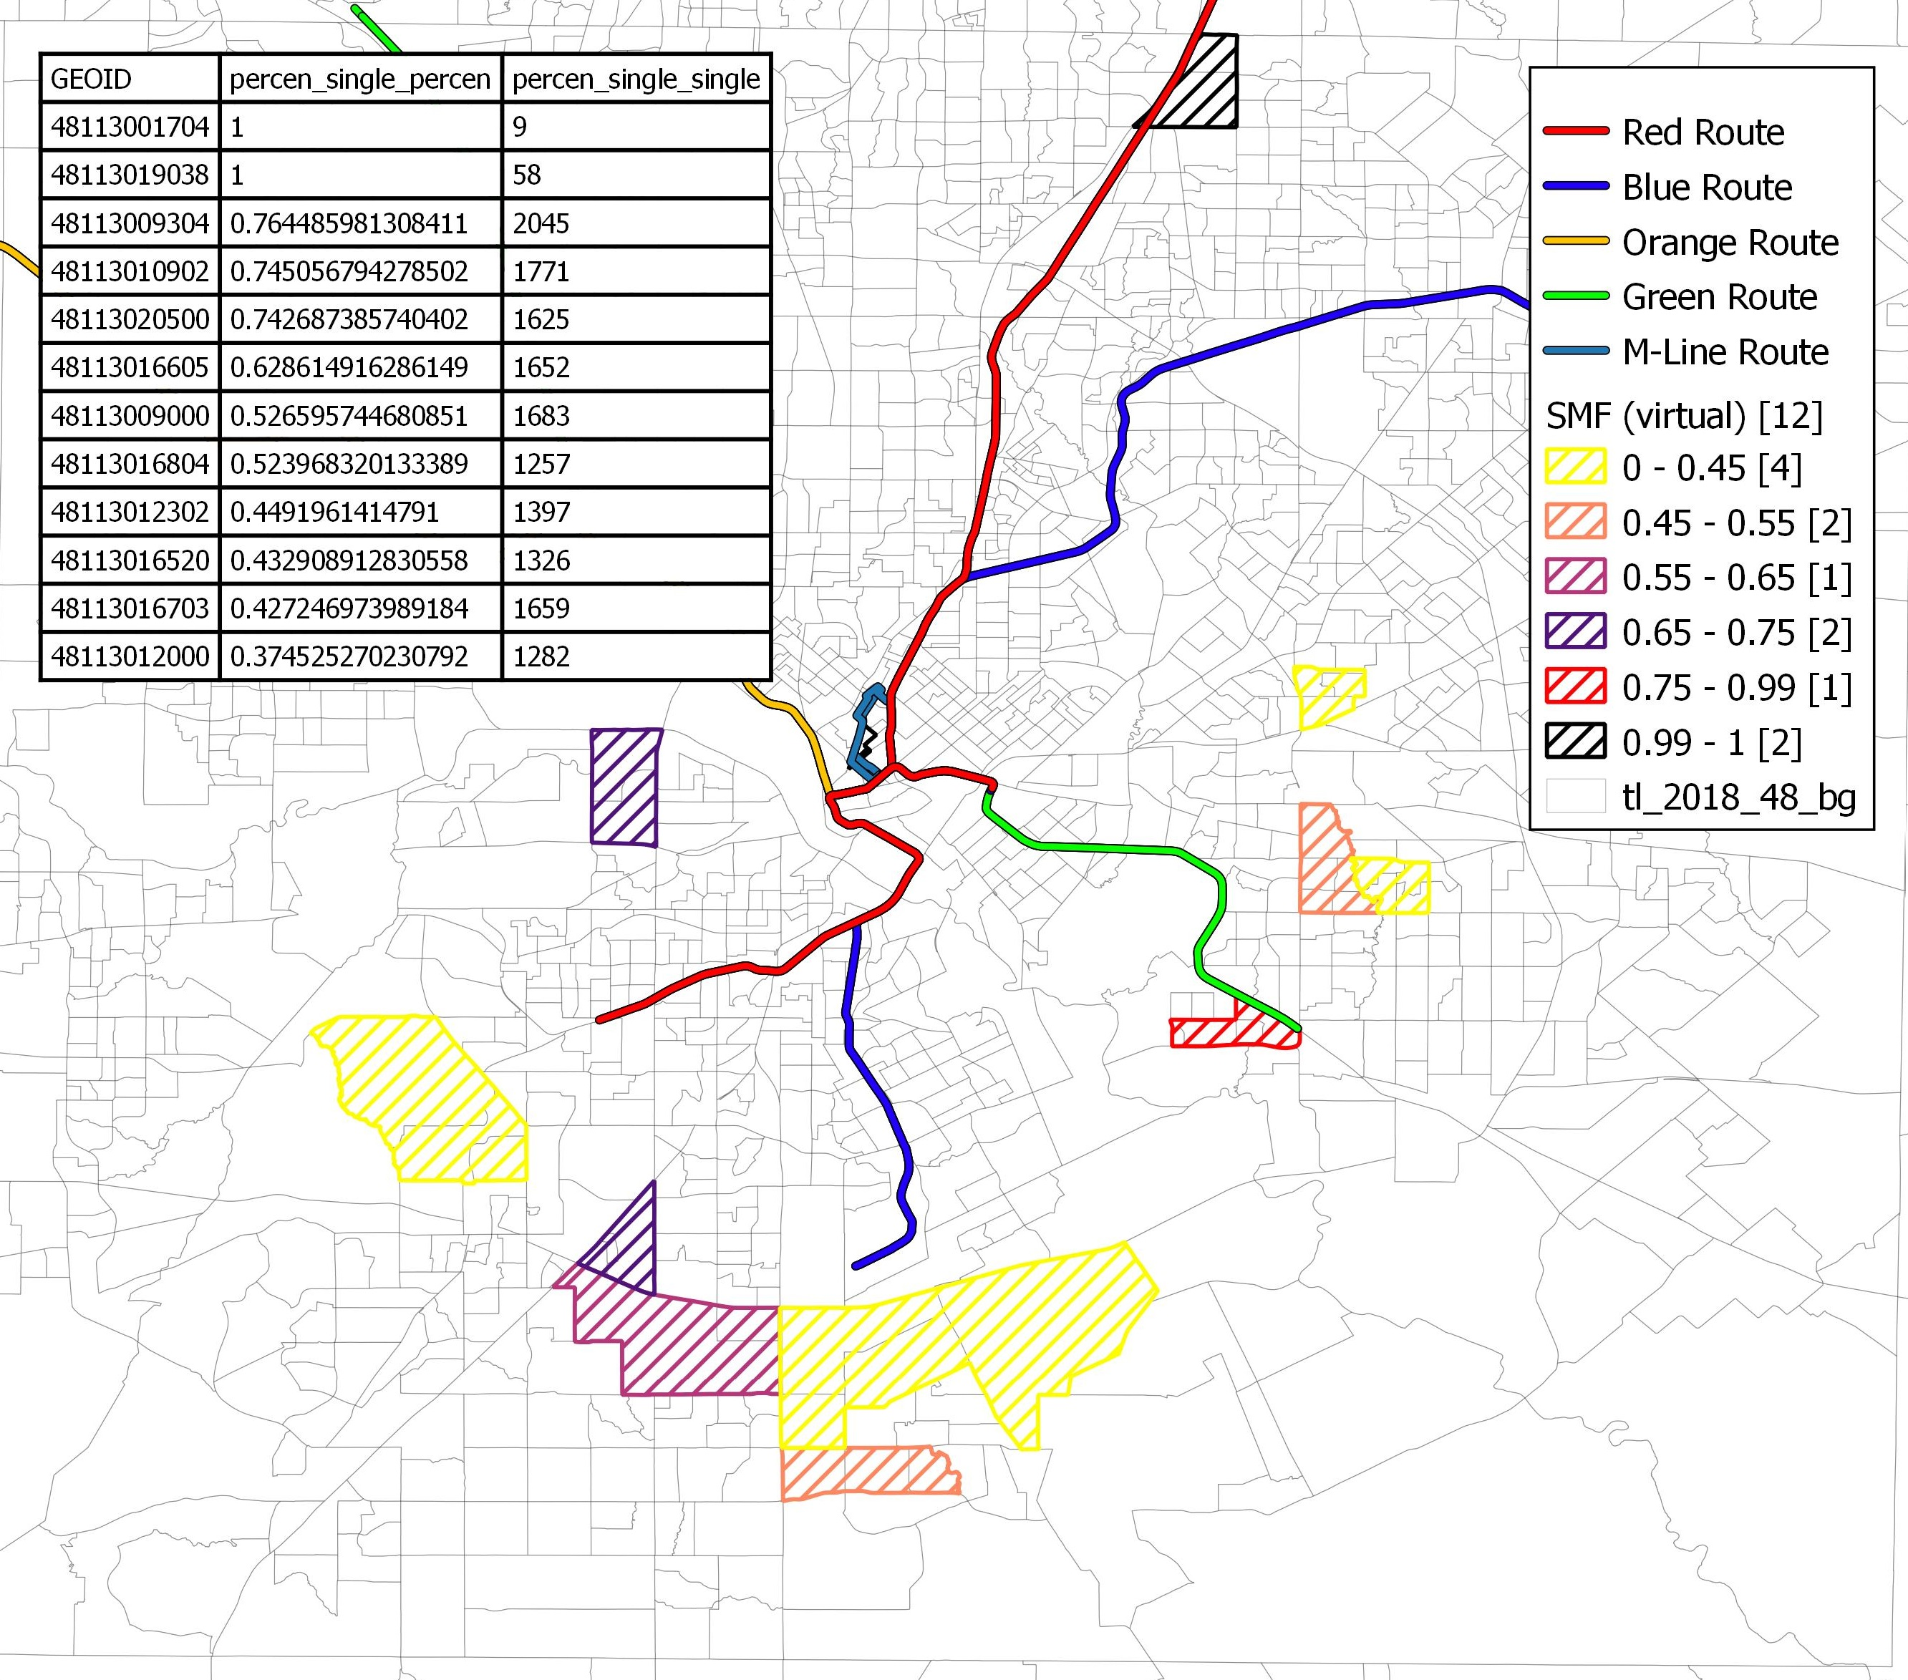
Top 10 Census Tracts with Highest Number of Single Mother Families
Percentage of Single Mother Families = Amount of Single Mother Families in that CBG / Total Amount of Families in that CBG (Only Consider families)
Notes:
Sorted by number has almost different result from sorting using only percentage. Sorted by number showing south part of city have high amount of single mother family

Slide 25
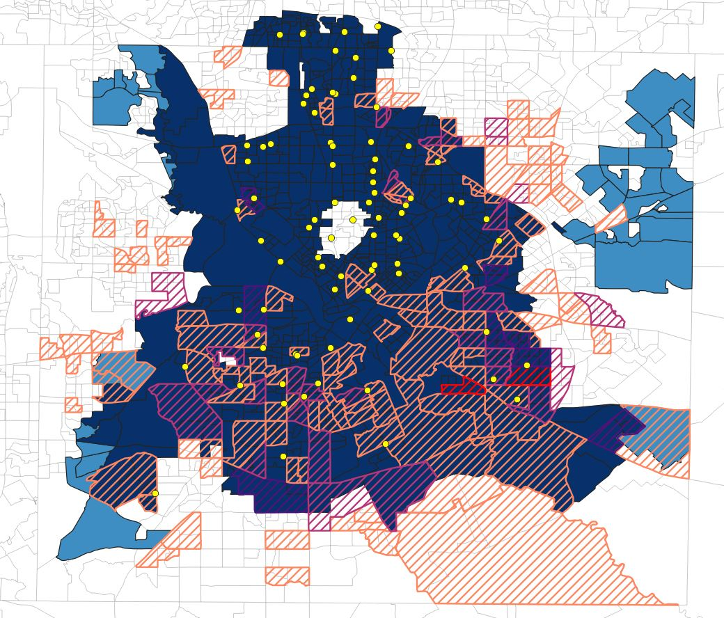
Grocery Stores By Car
Dark Blue
0 – 15 Mins (96.33%)
Blue
15 – 30 Mins (3.67%)
30 – 45 Mins (0%)
Light Blue
45 – 60 Mins (0%)
White
Slash
Percentage of Children in Poverty

Slide 26
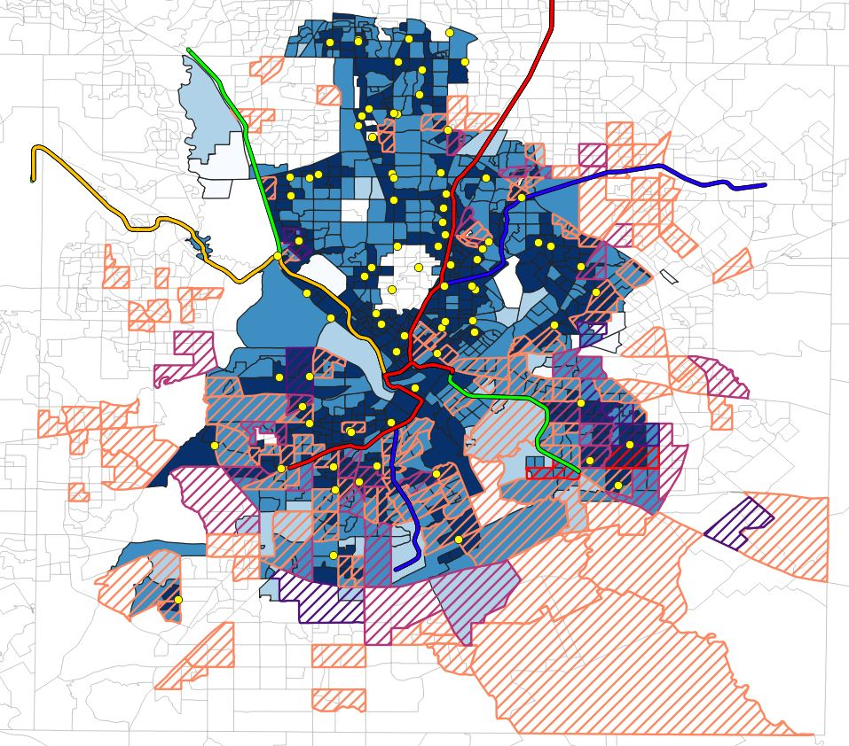
Grocery Stores By Transit
Dark Blue
0 – 15 Mins (45.46%)
Blue
15 – 30 Mins (41.97%)
30 – 45 Mins (3.79%)
Light Blue
45 – 60 Mins (0.9%)
White
Slash
Percentage of Children in Poverty

Slide 27
Grocery Stores Insights
Majority of CBGs can reach a grocery store within 30 mins by Car or by Transit

Slide 28
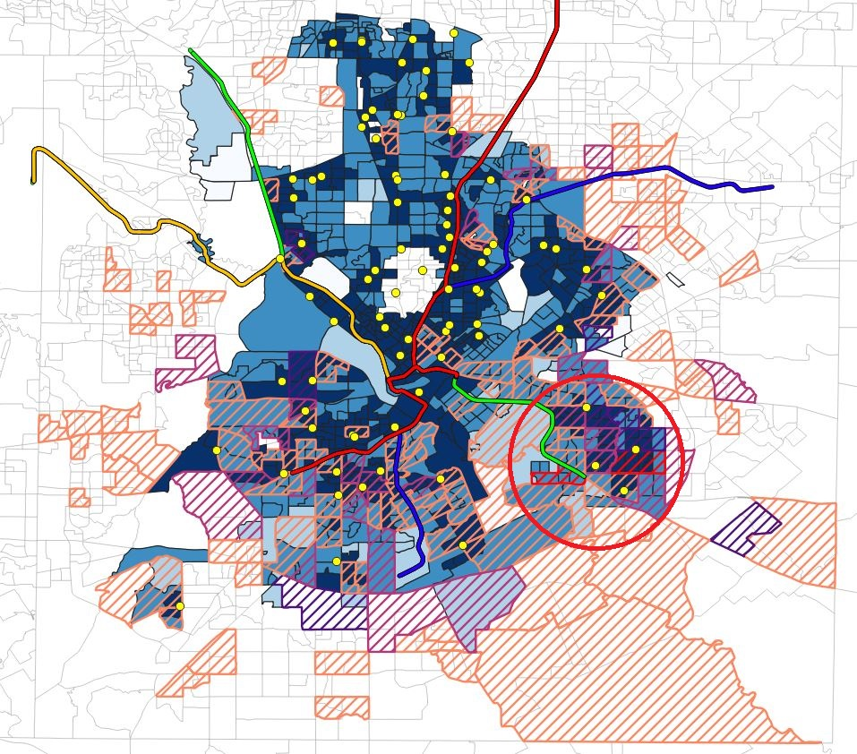
Grocery Stores Insights
Getting Groceries are not the most challenging thing

Slide 29
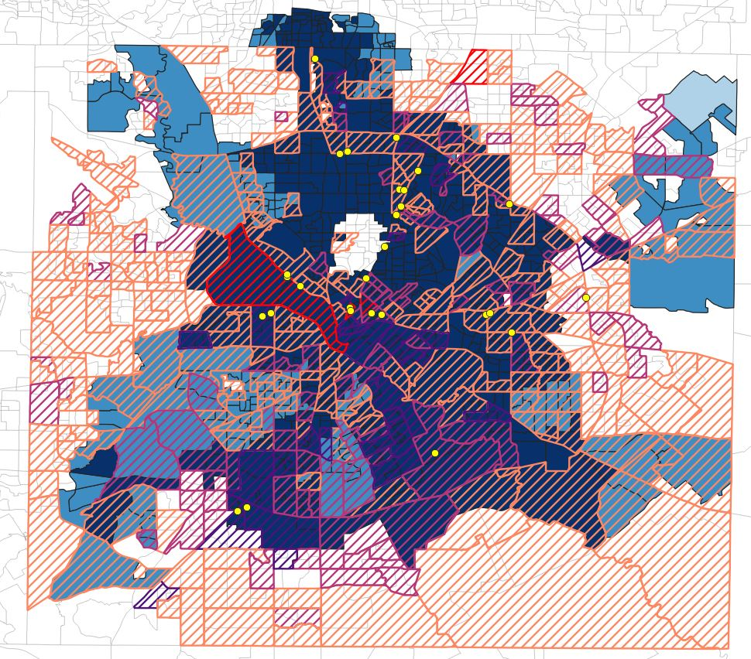
Women’s Clinics By Car
Dark Blue
0 – 15 Mins (77.18%)
Blue
15 – 30 Mins (22.72%)
30 – 45 Mins (0.1%)
Light Blue
45 – 60 Mins (0%)
White
Slash
Percentage of Single Mother Families

Slide 30
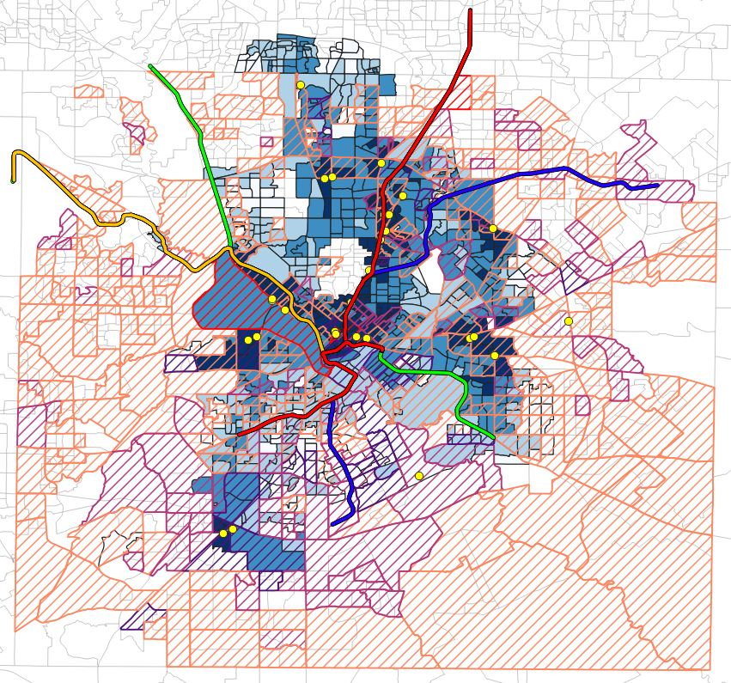
Women’s Clinics By Transit
Dark Blue
0 – 15 Mins (15.35%)
Blue
15 – 30 Mins (28.41%)
30 – 45 Mins (26.12%)
Light Blue
45 – 60 Mins (14.26%)
White
Slash
Percentage of Single Mother Families

Slide 31
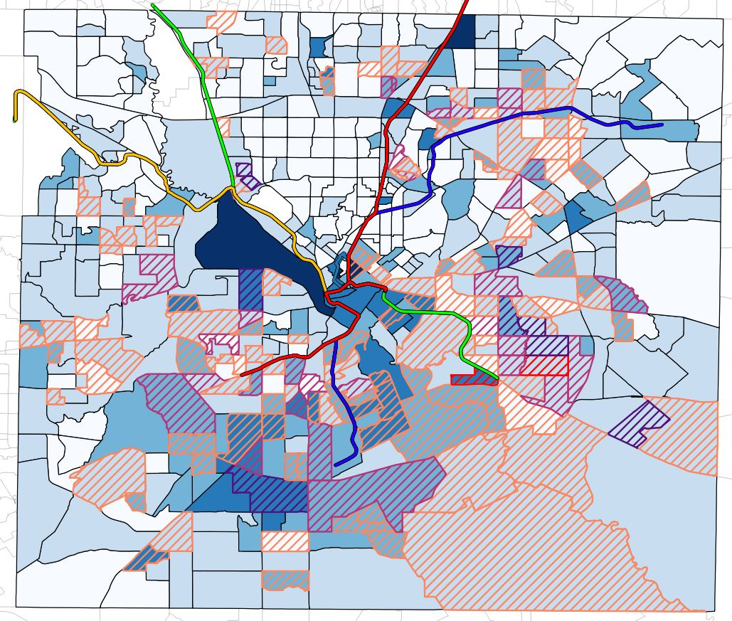
Combination Map
Children in Poverty
Red Means Highest Percentage of Children in Poverty
Single Mother Families
Darkest Blue Means Highest Percentage of Single Mother Families

Slide 32
Women’s Clinics Insights
Only 43.76% of CBGs can access to women's clinic within 30 mins by Transit

Slide 33
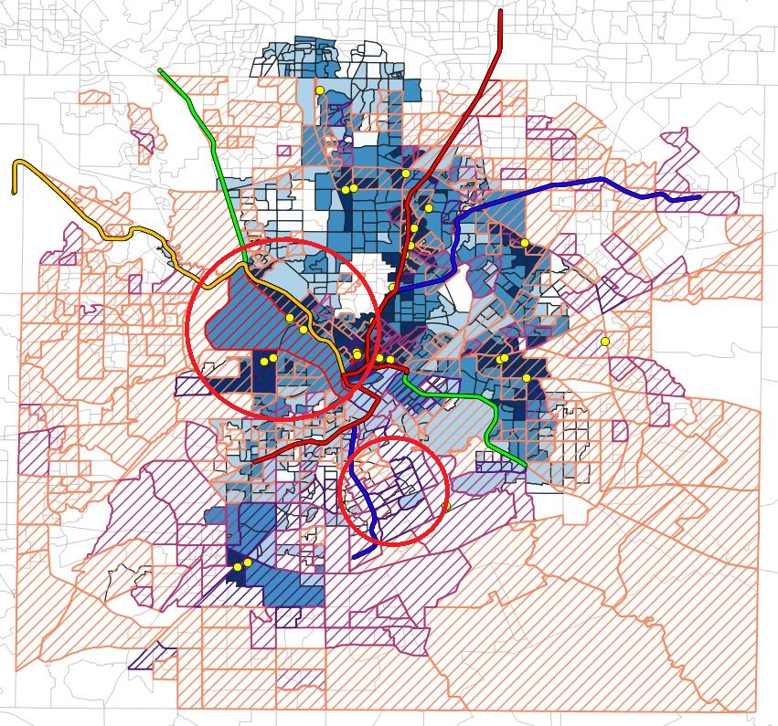
Women’s Clinics Insights
South part of City have limited access to the Women’s Clinics

Slide 34
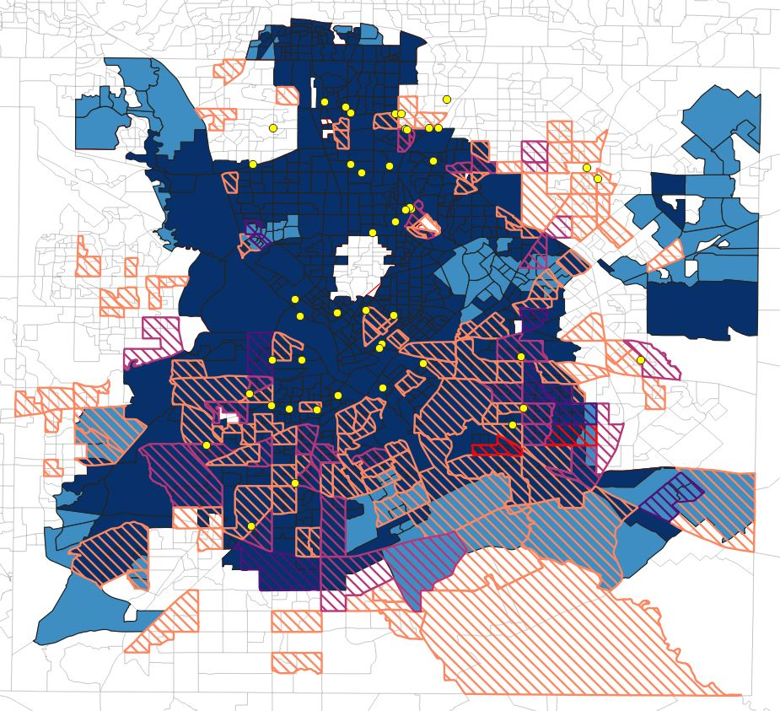
Basic Medical Clinics By Car
Dark Blue
0 – 15 Mins (87.77%)
Blue
15 – 30 Mins (12.23%)
30 – 45 Mins (0%)
Light Blue
45 – 60 Mins (0%)
White
Slash
Percentage of Children in Poverty

Slide 35
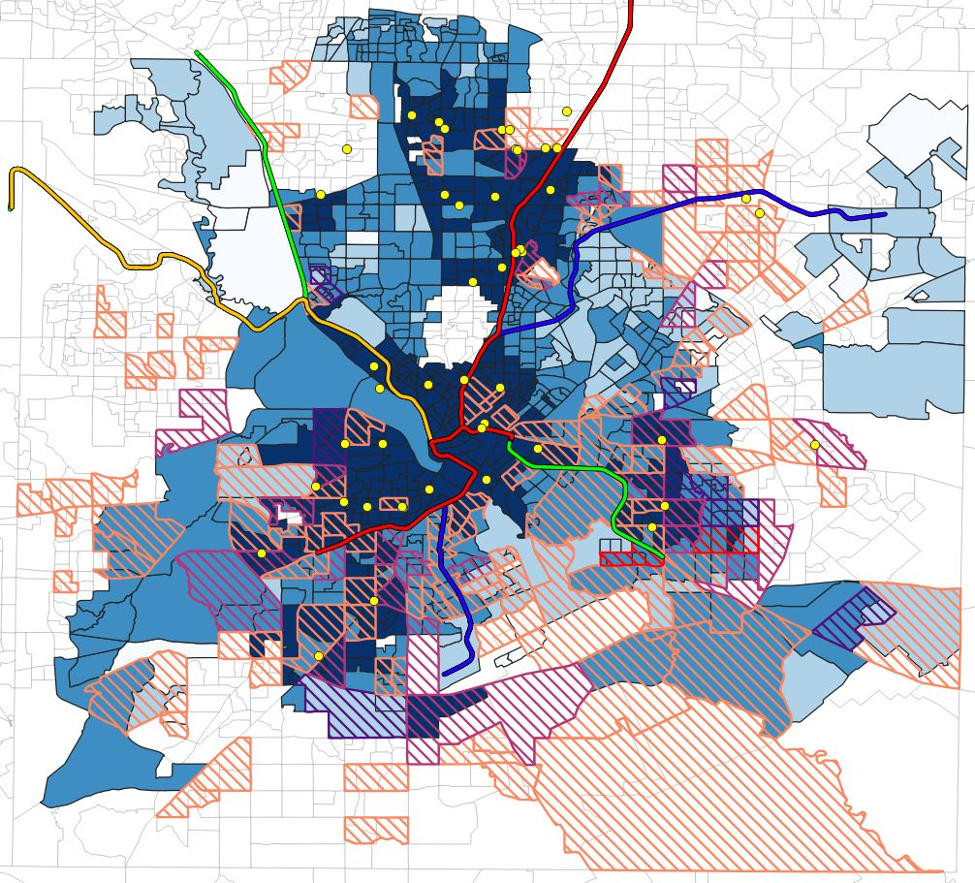
Basic Medical Clinics By Transit
Dark Blue
0 – 15 Mins (38.19%)
Blue
15 – 30 Mins (39.98%)
30 – 45 Mins (14.46%)
Light Blue
45 – 60 Mins (2.99%)
White
Slash
Percentage of Children in Poverty

Slide 36
Basic Medical Clinics Insights
Only 80% of CBGs can reach a Clinic within 30 mins by Transit

Slide 37
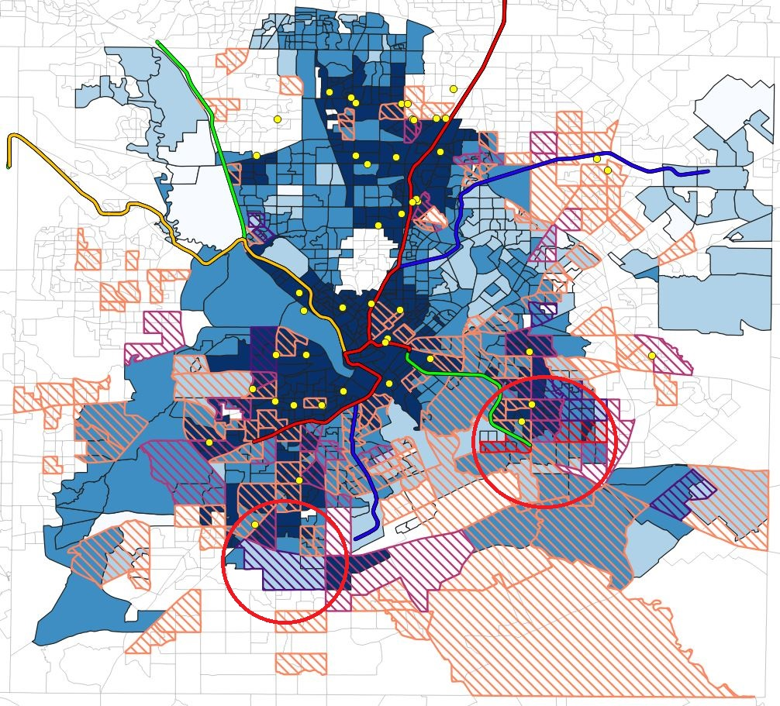
Basic Medical Clinics Insights
South part of City has limited access to the Clinics via Public Transportation

Slide 38
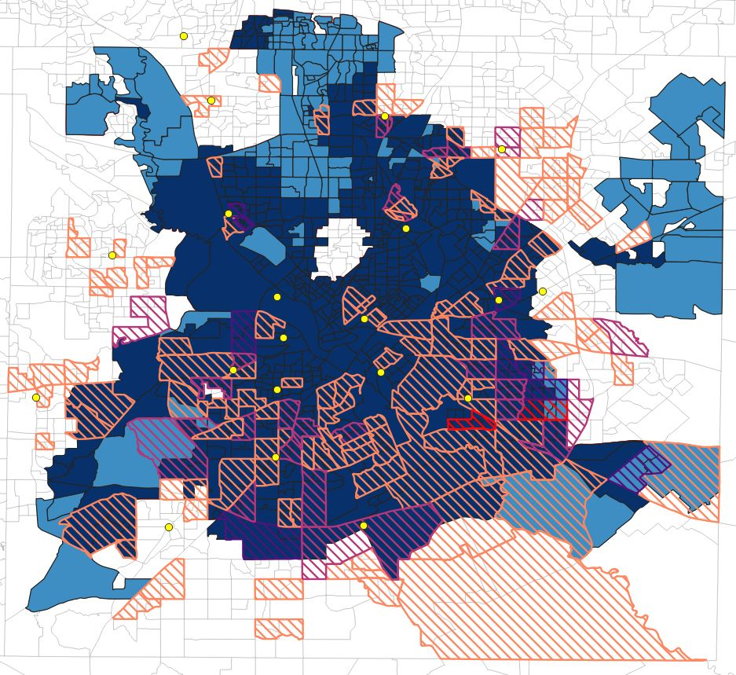
WIC Centers By Car
Dark Blue
0 – 15 Mins (83.28%)
Blue
15 – 30 Mins (16.72%)
30 – 45 Mins (0%)
Light Blue
45 – 60 Mins (0%)
White
Slash
Percentage of Children in Poverty

Slide 39
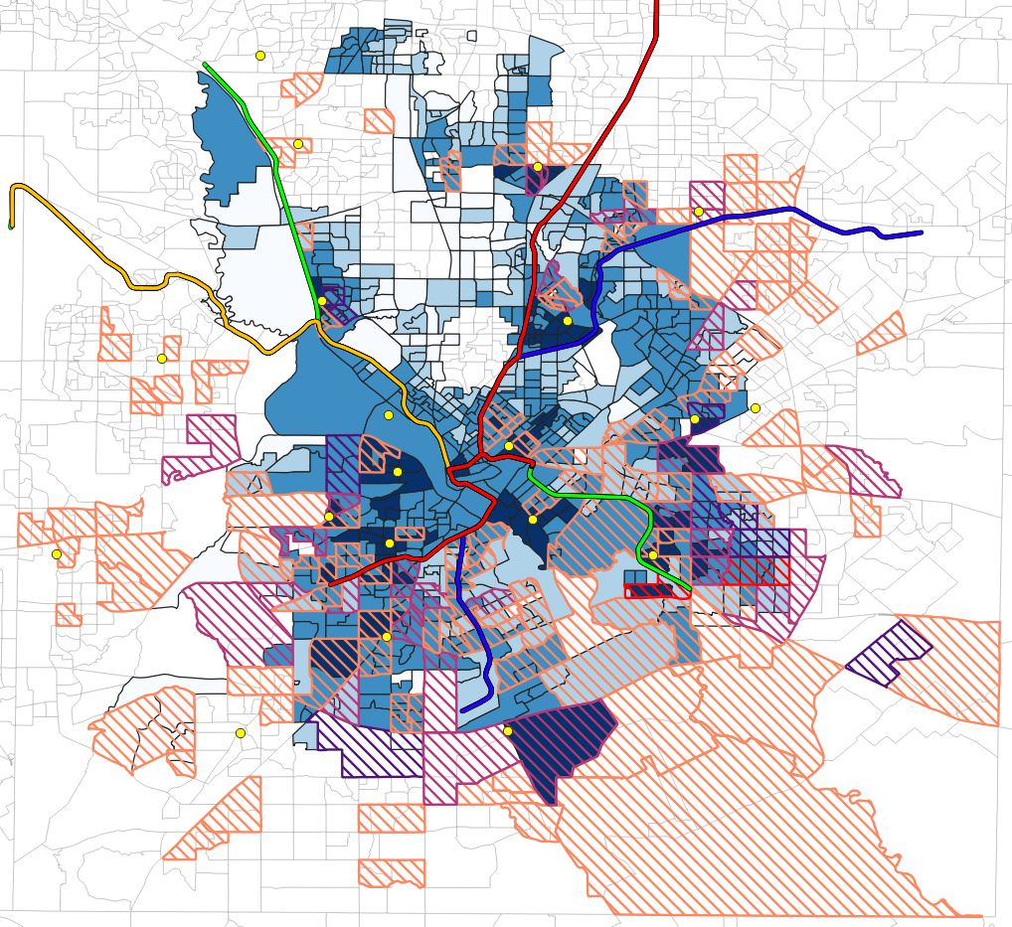
WIC Centers By Transit
Dark Blue
0 – 15 Mins (9.87%)
Blue
15 – 30 Mins (43.67%)
30 – 45 Mins (24.73%)
Light Blue
45 – 60 Mins (8.87%)
White
Slash
Percentage of Children in Poverty

Slide 40
WIC Centers By Transit
Travel Time
Below 30 Mins
30 – 40 Mins
40 – 50 Mins
50 – 60 Mins
Average Waiting Time
0
1.82
4.35
11.84
Notes:
we can largely decrease the travel time by Increasing or Optimizing the frequency of the bus or DART

Slide 41
WIC Centers Insights
Only 53.54% of CBGs can reach a WIC center within 30 mins by Transit

Slide 42
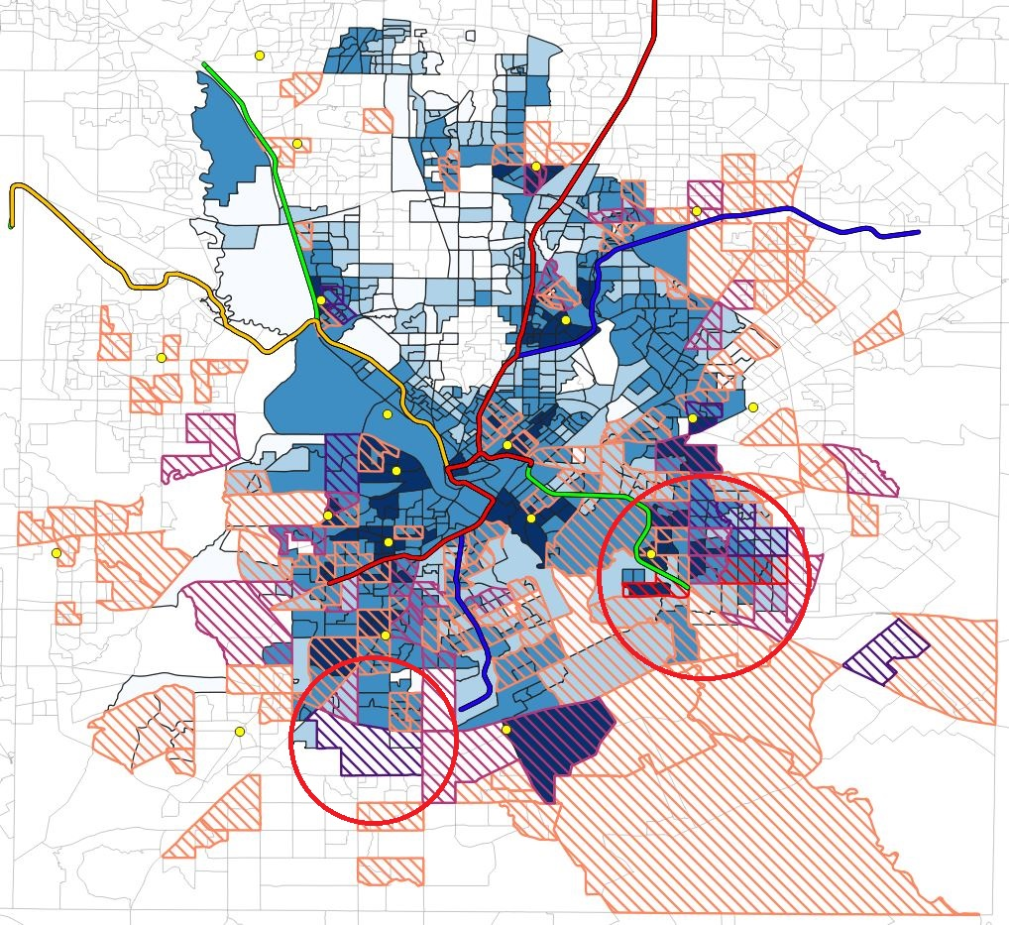
WIC Centers Insights
Southern part of City with High Percentage of Children in poverty commute for more than 45 mins

Slide 43
Summary
Transit | Grocery | Women’s Clinic | Basic Medical Clinic | WIC Center
Within 30 Mins | 87.43% | 43.76% | 78.17% | 53.54%
Above 30 Mins | 21.83% | 56.24% | 21.83% | 46.46%

Slide 44
Thank You!!

